Slide 1
Optimizing Musculotendon Parameters to Simulate Walking with Ankle-Foot Orthoses in Children with Cerebral Palsy
Ava C. Lakmazaheri, Michael C. Rosenberg, Andrew J. Ries,
Michael H. Schwartz, Katherine M. Steele
8/21/2019

Slide 2
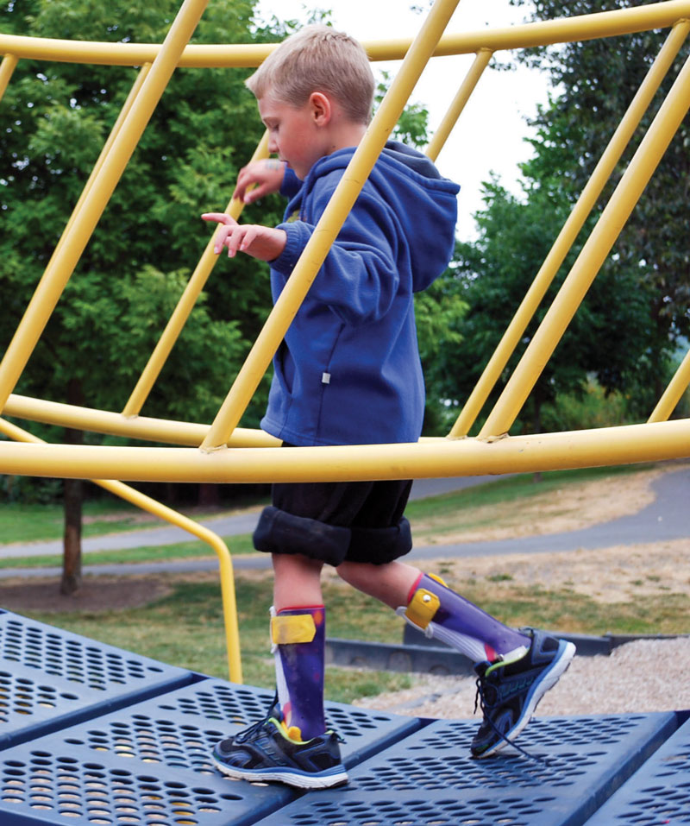
Motivation
Ankle-Foot Orthoses (AFOs) are commonly prescribed to children with cerebral palsy (CP) to assist locomotion
Musculoskeletal modeling may improve individualized AFO prescription
1
braceworks.ca/2016/05/09/devices/lower-limbs/afo/stability-for-cp-afos/

Slide 3
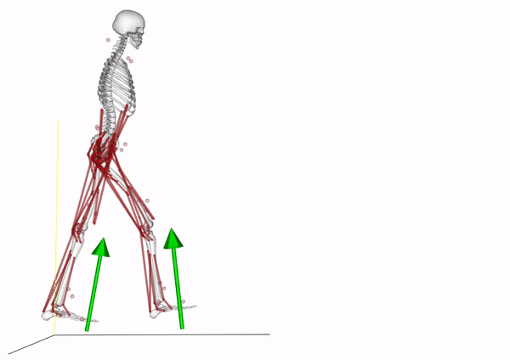
Musculoskeletal Modeling
Altered motor control
Altered musculotendon properties
AFOs
Altered kinematics
Brain Dynamics
Activation Dynamics
Musculotendon Dynamics
Skeletal Dynamics
Excitation
Activation
Muscle Force
Motion, Forces
2
Seth A, et al. PLoS Comput Biol, 14(7), 2018.

Slide 4
Driving Questions
Can optimizing musculotendon parameters improve simulated muscle activity for children with CP while walking with AFOs?
Can changing musculotendon dynamics capture altered brain dynamics?
3

Slide 5













Musculotendon Dynamics
$${\text{ℓ}}_{o}^{M}$$
$${\text{F}}_{o}^{M}$$
α
$${\text{ℓ}}_{s}^{T}$$
Tendon slack length
Optimal fiber length
Maximum isometric force
Pennation angle
Activation time constant
Deactivation time constant
α
$${\text{ℓ}}_{o}^{M}$$
$${\text{ℓ}}_{s}^{T}$$
$${\text{F}}_{o}^{M}$$
Force-Length
Activation-Time
α
$${\text{τ}}_{act}$$
$${\text{F}}_{o}^{M}$$
$${\text{τ}}_{deact}$$
$${\text{ℓ}}_{s}^{T}$$
$${\text{ℓ}}_{o}^{M}$$
$${\text{τ}}_{act}$$
$${\text{τ}}_{deact}$$
4

Slide 6
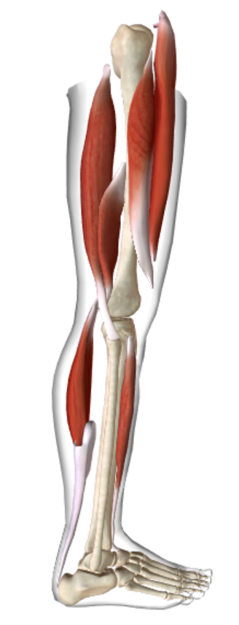
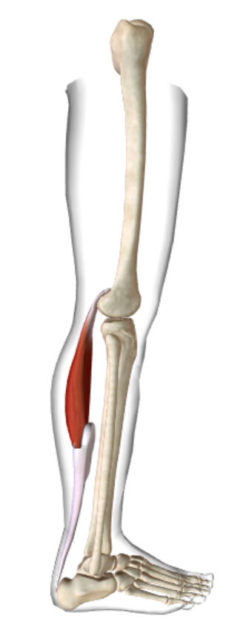
Musculotendon Dynamics
Vastus Intermedius (VI)
Biceps Femoris (BF)
Rectus Femoris (RF)
Medial Gastrocnemius (MG)
Tibialis Anterior (TA)
5
Barber L, et al. Dev Med & Child Neurol, 53, 2011.
/ biodigital.com

Slide 7
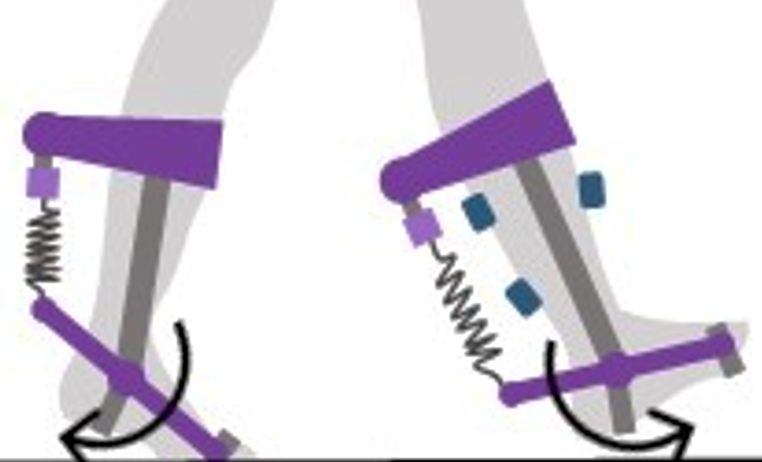
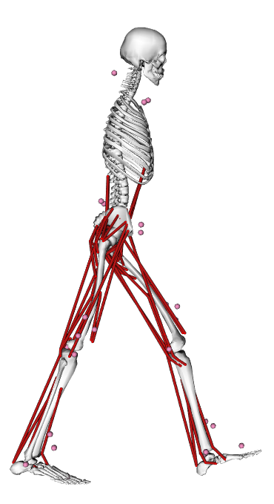
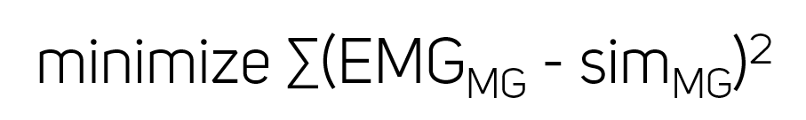
Methods
Motion Capture Data
Inverse Kinematics
Estimate Muscle Activity
Simulated Muscle Activation (sim)
minimize ∑activations²
-
Electromyography (EMG) Muscle Excitation
+
Generic
Musculotendon
Parameters
Musculoskeletal Model
MATLAB Optimizer
Updated Musculotendon
Parameters
6
Meyer AJ, et al. PLoS ONE, 12(7), 2017.

Slide 8
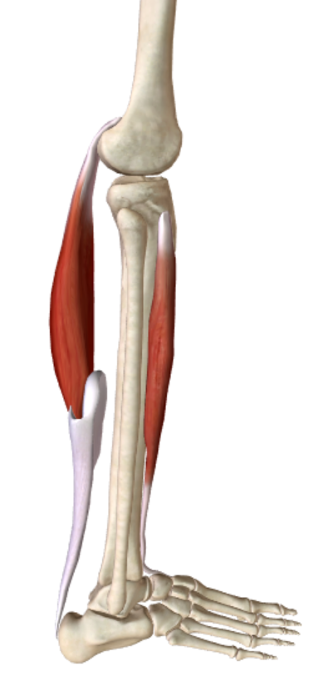
Activation Analysis
1
MG
MG Error
Muscle Activation
0
MG
Muscle Activation
1
0
20
40
60
80
100
TA
TA
% Gait Cycle
EMG (target)
Default Simulation
Optimized Simulation
0
0
20
40
60
80
100
% Gait Cycle
7
Steele KM, et al. Dev Med Child Neurol, 57(12), 2015.

Slide 9
Discussion
Can optimizing musculotendon parameters improve simulated muscle activity for children with CP while walking with AFOs?
Yes! Improve results by prioritizing regions with high initial error and/or tuning additional muscles
Can changing musculotendon dynamics capture altered brain dynamics?
No, muscles should be constrained for co-activation in the musculoskeletal model
8

Slide 10
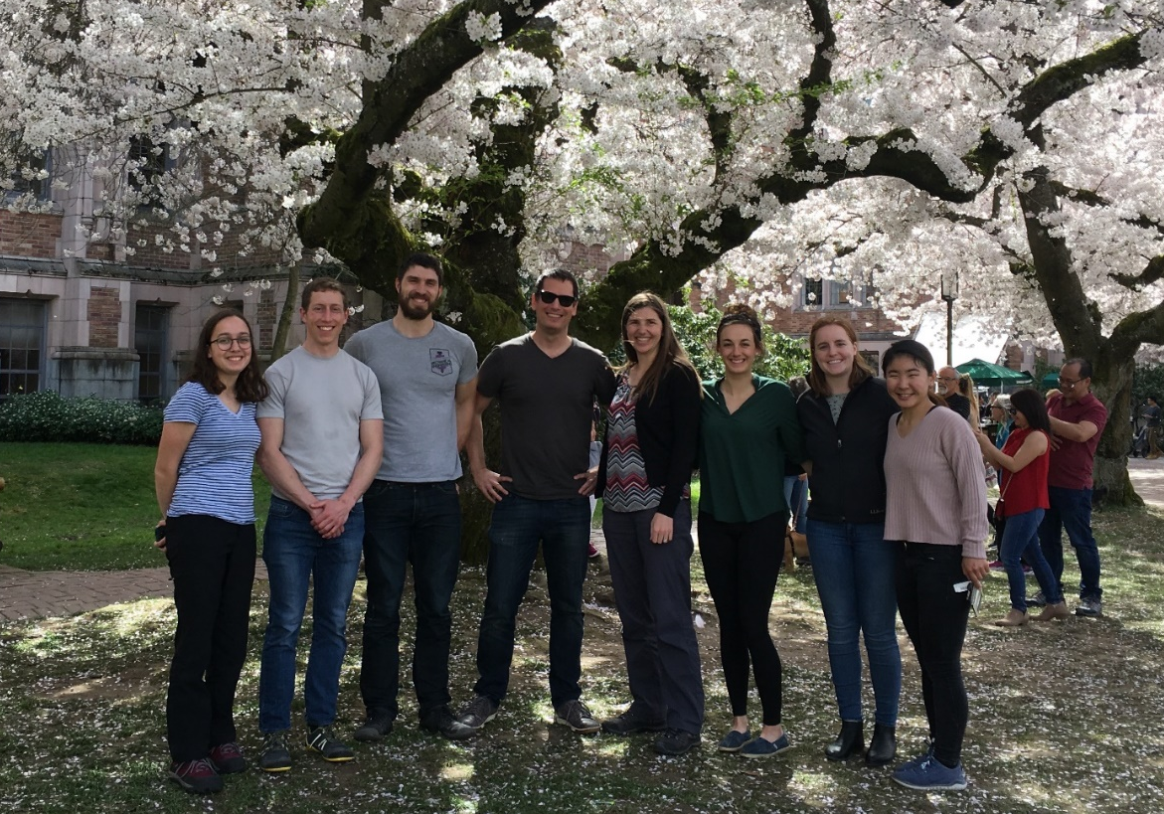



Acknowledgments
Thanks to the Ability & Innovation Lab and Wing-Sum Law, the National Science Foundation, the Center for Neurotechnology, and Gillette Children's Specialty Healthcare!
9

